Slide 1
Unit V
Classification and Prediction

Slide 2
Classification and Prediction
What is classification? What is prediction?
Issues regarding classification and prediction
Classification by decision tree induction
Bayesian Classification
Classification by Neural Networks,Back propagation
Support Vector Machines (SVMs)
k-nearest neighbour classifier
Other Classification Methods
Prediction
Classification accuracy
Summary

Slide 3
Classification vs. Prediction
Classification:
predicts categorical class labels (discrete or nominal)
classifies data (constructs a model) based on the training set and the values (class labels) in a classifying attribute and uses it in classifying new data.
Prediction:
models continuous-valued functions, i.e., predicts unknown or missing values
Typical Applications
credit approval
target marketing
medical diagnosis
treatment effectiveness analysis

Slide 4
Classification—A Two-Step Process
Model construction: describing a set of predetermined classes
Model usage: for classifying future or unknown objects

Slide 5
Classification—A Two-Step Process
Model construction: describing a set of predetermined classes
Each tuple/sample is assumed to belong to a predefined class, as determined by the class label attribute
The set of tuples used for model construction is training set
The model is represented as classification rules, decision trees, or mathematical formulae
Model usage: for classifying future or unknown objects
Estimate accuracy of the model
The known label of test sample is compared with the classified result from the model
Accuracy rate = % of test set samples that are correctly classified by the model
Test set is independent of training set, otherwise over-fitting will occur
If the accuracy is acceptable, use the model to classify data tuples whose class labels are not known

Slide 6
Classification Process (1): Model Construction
Classification
Algorithms
Training
Data
Classifier
(Model)
IF rank = ‘professor’
OR years > 6
THEN tenured = ‘yes’

Slide 7
Classification Process (2): Use the Model in Prediction
Classifier
Testing
Data
Unseen Data
(Jeff, Professor, 4)
Tenured?

Slide 8
Supervised vs. Unsupervised Learning
Supervised learning (classification)
Supervision: The training data are accompanied by labels indicating the class of the observations
New data is classified based on the training set
Unsupervised learning (clustering)
The class labels of training data is unknown
Given: a set of measurements, observations, etc.
Aim: Establish the existence of classes or clusters in the data

Slide 9
Chapter 7. Classification and Prediction
What is classification? What is prediction?
Issues regarding classification and prediction
Classification by decision tree induction
Bayesian Classification
Classification by Neural Networks
Classification by Support Vector Machines (SVM)
Classification based on concepts from association rule mining
Other Classification Methods
Prediction
Classification accuracy
Summary

Slide 10
Issues Regarding Classification and Prediction: 1. Data Preparation
Issues are :
1. Data Preparation: helps improve efficiency, accuracy and scalability of classification and prediction
2. Comparing Classification Methods
Data cleaning
Preprocess data in order to reduce noise and handle missing values
Relevance analysis (feature selection)
Remove the irrelevant or redundant attributes. This avoids slow-down, misleading of the learning step.
Data transformation
Generalize and/or normalize data. Concept hierarchies can be used.

Slide 11
Issues regarding classification and prediction: 2. Comparing Classification Methods
Predictive accuracy :
ability of the model to correctly predict the class label of new/unseen data.
Speed
time to construct the model
time to use the model
Robustness
handling noise and missing values
Scalability
efficiency of the model for large databases
Interpretability:
understanding the insight provided by the model
Goodness of rules
decision tree size
compactness of classification rules

Slide 12
Chapter 7. Classification and Prediction
What is classification? What is prediction?
Issues regarding classification and prediction
Classification by decision tree induction
Bayesian Classification
Classification by Neural Networks
Classification by Support Vector Machines (SVM)
Classification based on concepts from association rule mining
Other Classification Methods
Prediction
Classification accuracy
Summary

Slide 13
Training Dataset
This follows an example from Quinlan’s ID3

Slide 14
Output: A Decision Tree for “buys_computer”
age?
<=30
overcast
>40
30..40
student?
yes
credit rating?
no
yes
excellent
fair
no
yes
no
yes

Slide 15
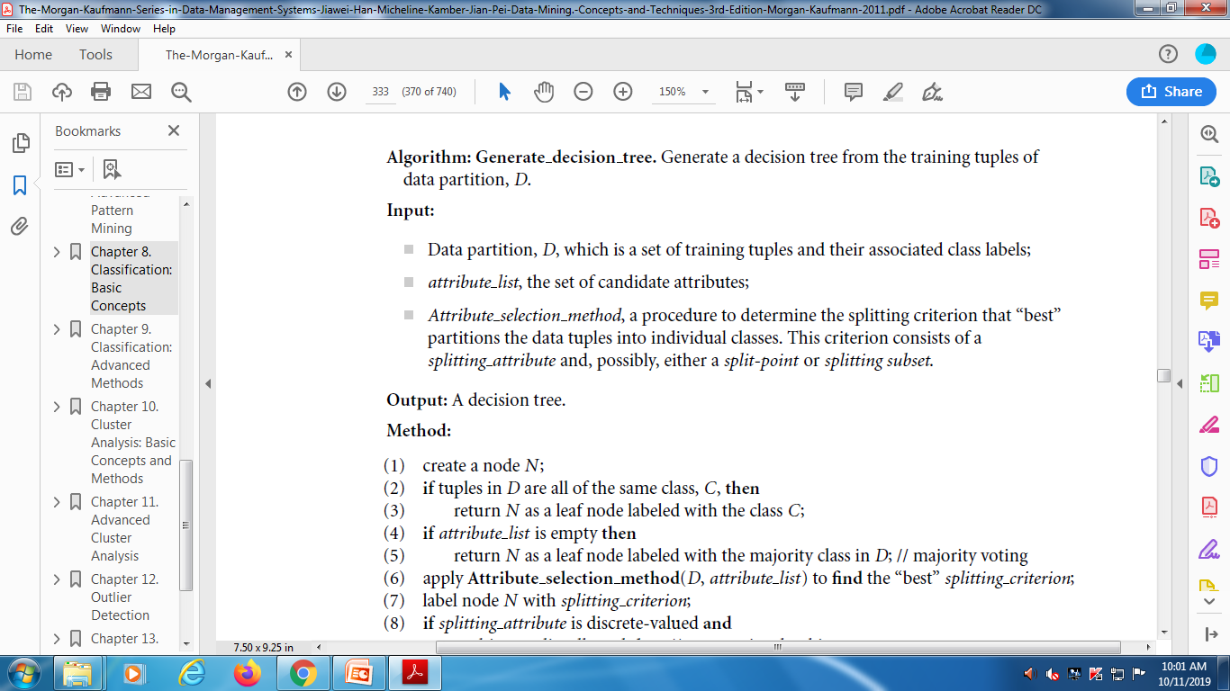
Basic algorithm for inducing a decision tree from training tuples

Slide 16
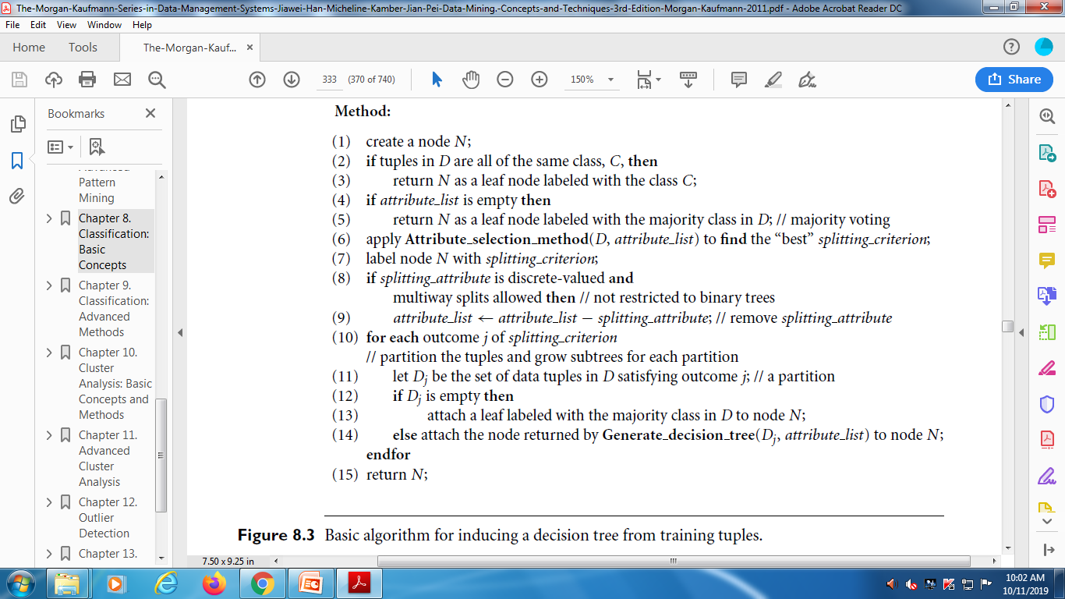
Basic algorithm for inducing a decision tree from training tuples (contd..)

Slide 17
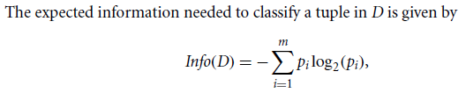


Attribute Selection Measures
Information Gain

Slide 18
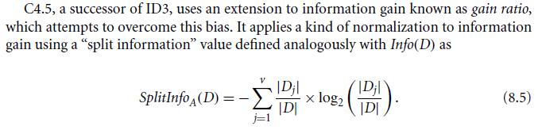

Gain Ratio

Slide 19
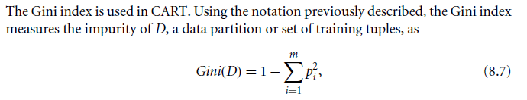
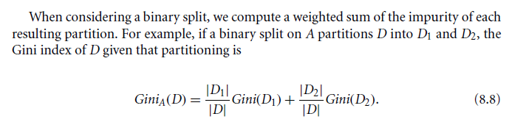
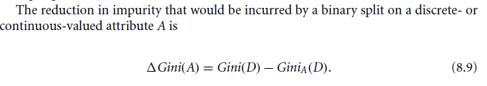
Gini Index

Slide 20
Attribute Selection Measure: Information Gain (ID3/C4.5)
Select the attribute with the highest information gain
S contains s_{i} tuples of class C_{i} for i = {1, …, m}
information measures: info required to classify any arbitrary tuple
entropy of attribute A with values {a₁,a₂,…,a_{v}}
information gained by branching on attribute A
Notes:
Then how can we decide a test attribute on each node?
One of the popular methods is using information gain measure, which we covered in chapter 5.
It involves rather complicated equations, and I’ll not present the details here. Just basic ideas.
The basic idea is that we select the attribute with the highest information gain.
This information gain can be calculated from the expected information I and entropy of each attribute, E
I : the expected information needed to classify a given sample
E (entropy) : expected information based on the partitioning into subsets by A

Slide 21
Attribute Selection by Information Gain Computation
Class P: buys_computer = “yes”
Class N: buys_computer = “no”
I(p, n) = I(9, 5) =0.940
Compute the entropy for age:
means “age <=30” has 5 out of 14 samples, with 2 yes’es and 3 no’s. Hence
Similarly,

Slide 22
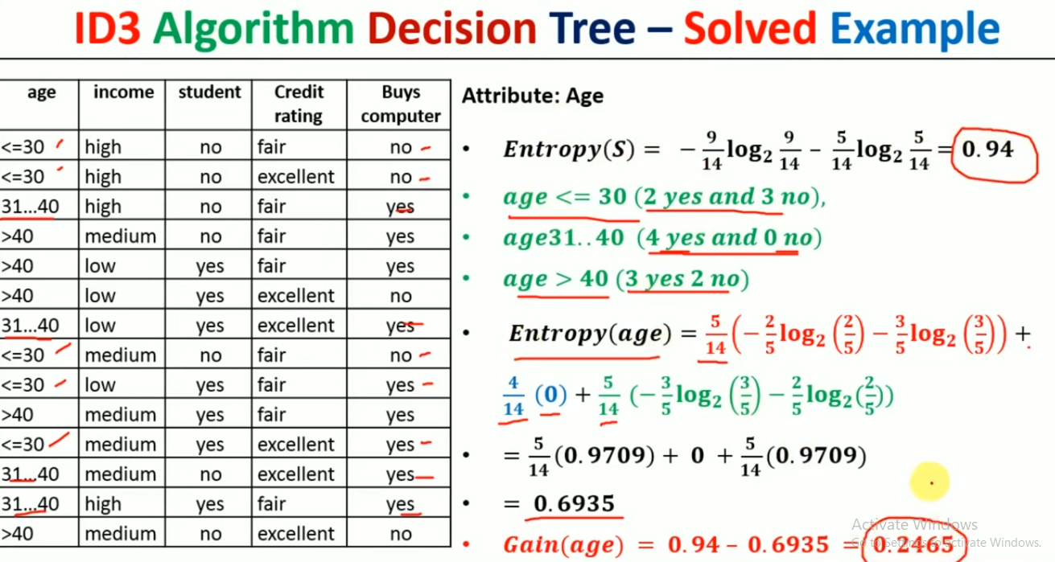

Slide 25
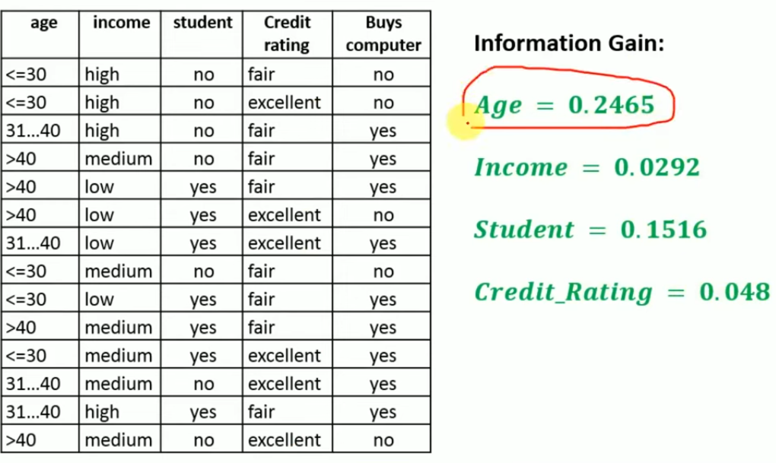

Slide 26
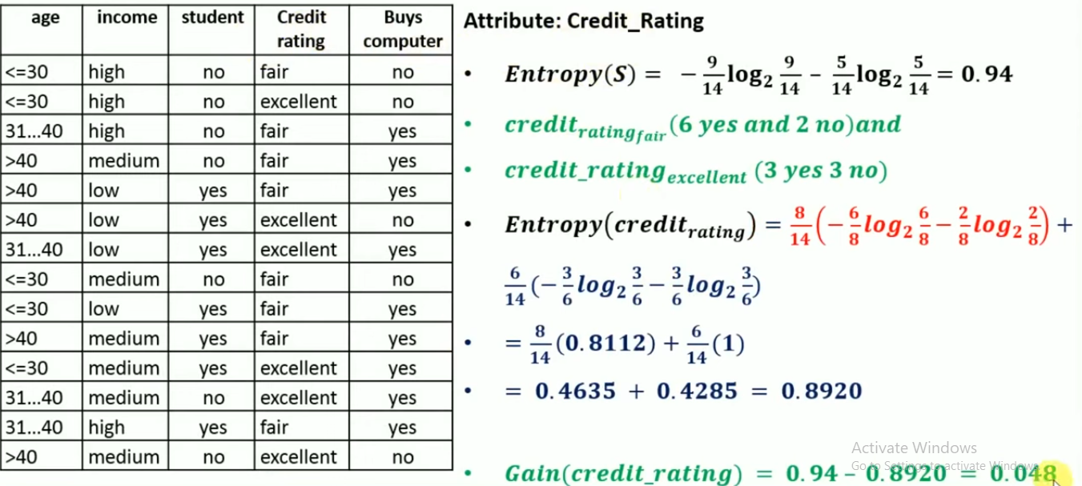

Slide 27
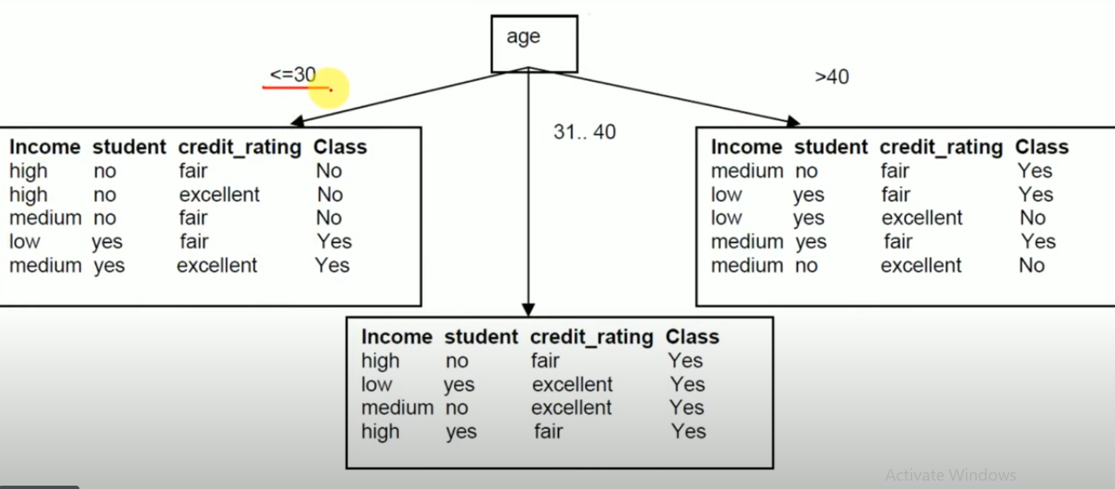
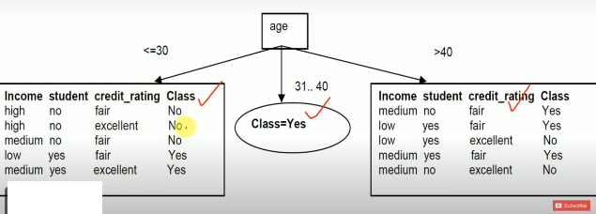

Slide 28
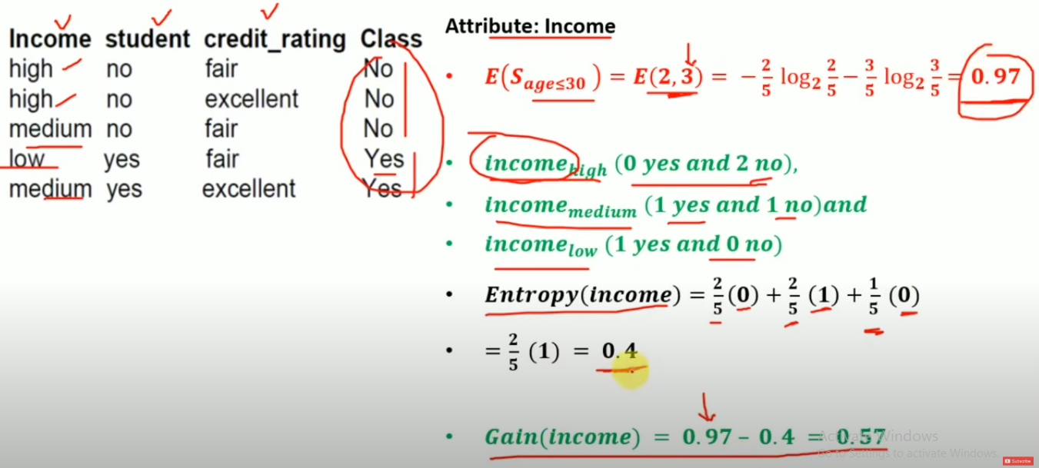

Slide 29
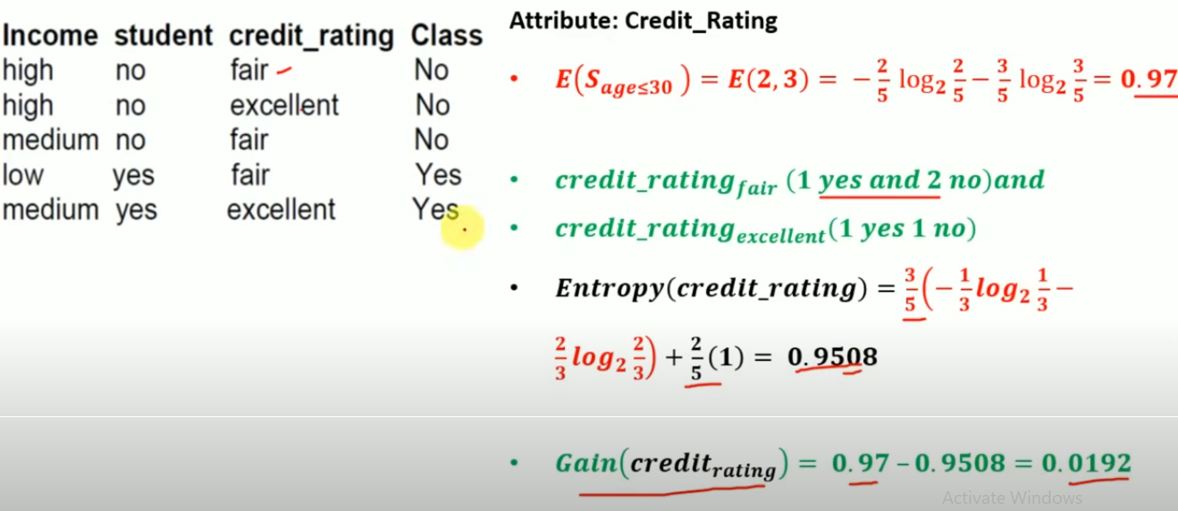

Slide 30
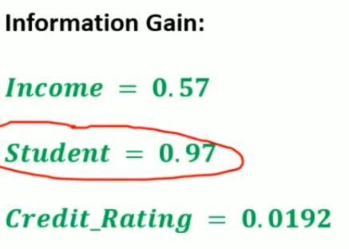
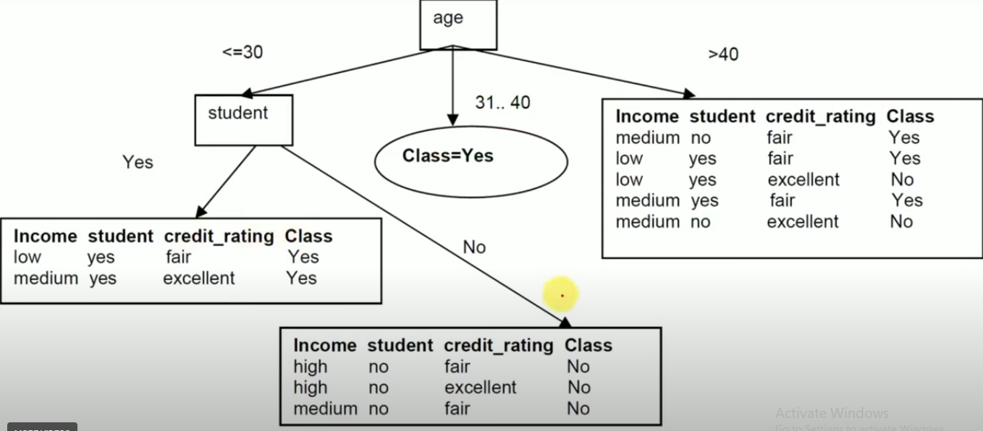

Slide 31
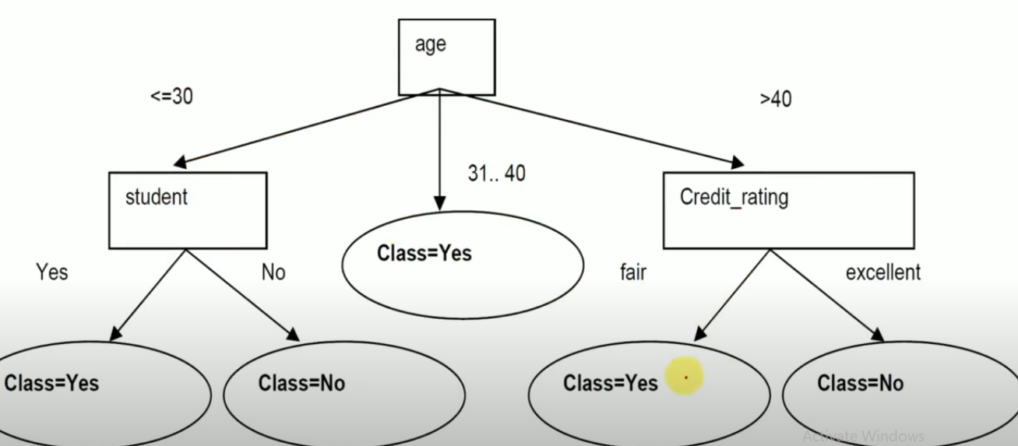

Slide 32
Tree Pruning: Avoid Overfitting in Classification
Overfitting: An induced tree may overfit the training data
Too many branches, some may reflect anomalies due to noise or outliers
Poor accuracy for unseen samples
Two approaches to avoid overfitting
Prepruning: Halt tree construction early—do not split a node if this would result in the goodness measure falling below a threshold
Difficult to choose an appropriate threshold
Postpruning: Remove branches from a “fully grown” tree—get a sequence of progressively pruned trees
Use a set of data different from the training data to decide which is the “best pruned tree”

Slide 33
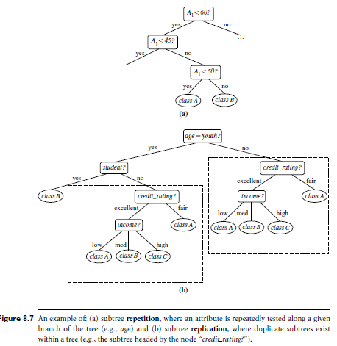

Slide 34
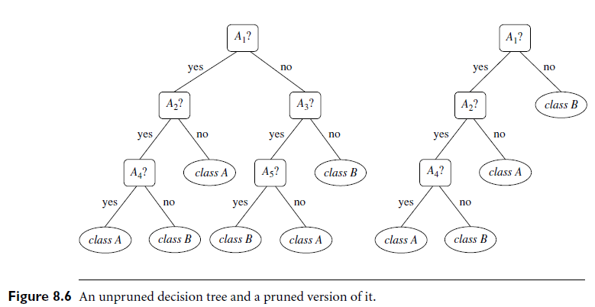

Slide 35
Extracting Classification Rules from Trees
Represent the knowledge in the form of IF-THEN rules
One rule is created for each path from the root to a leaf
Each attribute-value pair along a path forms a conjunction
The leaf node holds the class prediction
Rules are easier for humans to understand
Example
IF age = “<=30” AND student = “no” THEN buys_computer = “no”
IF age = “<=30” AND student = “yes” THEN buys_computer = “yes”
IF age = “31…40” THEN buys_computer = “yes” IF age = “>40” AND credit_rating = “excellent” THEN buys_computer = “yes”
IF age = “<=30” AND credit_rating = “fair” THEN buys_computer = “no”
age?
<=30
overcast
>40
30..40
student?
yes
credit rating?
no
yes
excellent
fair
no
yes
no
yes

Slide 36
Approaches to Determine the Final Tree Size
Separate training (2/3) and testing (1/3) sets
Use minimum description length (MDL) principle
halting growth of the tree when the encoding is minimized

Slide 37
Enhancements to basic decision tree induction
Allow for continuous-valued attributes
Dynamically define new discrete-valued attributes that partition the continuous attribute value into a discrete set of intervals
Handle missing attribute values
Assign the most common value of the attribute
Assign probability to each of the possible values
Attribute construction
Create new attributes based on existing ones that are sparsely represented
This reduces fragmentation, repetition, and replication

Slide 38
Classification in Large Databases
Classification—a classical problem extensively studied by statisticians and machine learning researchers
Scalability: Classifying data sets with millions of examples and hundreds of attributes with reasonable speed
Why decision tree induction in data mining?
relatively faster learning speed (than other classification methods)
convertible to simple and easy to understand classification rules
can use SQL queries for accessing databases
comparable classification accuracy with other methods

Slide 39
Scalable Decision Tree Induction Methods in Data Mining Studies
SLIQ
builds an index for each attribute and only class list and the current attribute list reside in memory
SPRINT
constructs an attribute list data structure
PUBLIC
integrates tree splitting and tree pruning: stop growing the tree earlier
RainForest
separates the scalability aspects from the criteria that determine the quality of the tree
builds an AVC-list (attribute, value, class label)

Slide 40
Chapter 7. Classification and Prediction
What is classification? What is prediction?
Issues regarding classification and prediction
Classification by decision tree induction
Bayesian Classification
Classification by Neural Networks,Back propagation
Support Vector Machines (SVMs)
k-nearest neighbour classifier
Other Classification Methods
Prediction
Classification accuracy
Summary

Slide 41
Bayesian Classification
Bayesian classifiers are statistical classifiers.
They can predict class membership probabilities:- probability that a given sample belongs to a particular class.
Have high accuracy and speed for large databases.
class conditional independence : Naive Bayesian classifiers assume that the effect of an attribute value on a given class is independent of the values of the other attributes.
It is made to simplify the computations involved, and in this sense, is considered “naive".

Slide 42
Bayesian Theorem Basics
Given training data X, posteriori probability of a hypothesis H, P(H|X) follows the Bayes theorem
Informally, this can be written as
posterior =likelihood x prior / evidence
Let
X- a data sample whose class label is unknown
H- hypothesis that X belongs to class C
For classification problems, determine P(H/X): the probability that the hypothesis holds given the observed data sample X
P(H): prior probability of hypothesis H (i.e. the initial probability before we observe any data, reflects the background knowledge)
P(X): probability that sample data is observed
P(X|H) : probability of observing the sample X, given that the hypothesis holds

Slide 43
Bayesian Classification: Practical difficulty
require initial knowledge of many probabilities, significant computational cost

Slide 44
Naive Bayesian classification
Suppose
1. Each data sample, X = (x1,x2,…,xn), depicting n measurements for n attributes, respectively A1,A2,…,An
2. There are m classes, C1,C2,…,Cm.
Given : unknown data sample, X
the naive Bayesian classier assigns an unknown sample X to the class Ci iff

Slide 45

By Bayes theorem
P(Ci/X)= P(X/Ci) * P(Ci)
P(X)
Probability of X conditioned
on Ci is given by
i.e., P(X/Ci) = P(x1/Ci) * P(x2/Ci) *…… *P(xn/Ci)
where unknown data sample, X=(x1,x2,…..xn)

Slide 46
Training dataset
Class:
C1:buys_computer=
‘yes’
C2:buys_computer=
‘no’
Data sample(unknown)
X =(age<=30,
Income=medium,
Student=yes
Credit_rating=
Fair)

Slide 47
Naïve Bayesian Classifier: Example Compute P(X/Ci) for each class
Data sample X =(age<=30, Income=medium, Student=yes Credit_rating= Fair)
P(age=“<30” | buys_computer=“yes”) = 2/9=0.222
P(age=“<30” | buys_computer=“no”) = 3/5 =0.6
P(income=“medium” | buys_computer=“yes”)= 4/9 =0.444
P(income=“medium” | buys_computer=“no”) = 2/5 = 0.4
P(student=“yes” | buys_computer=“yes)= 6/9 =0.667
P(student=“yes” | buys_computer=“no”)= 1/5=0.2
P(credit_rating=“fair” | buys_computer=“yes”)=6/9=0.667
P(credit_rating=“fair” | buys_computer=“no”)=2/5=0.4
P(buys_computer=“yes”)=9/14=0.643
P(buys_computer=“no”)=5/14=0.357
P(X|Ci) : P(X|buys_computer=“yes”)= 0.222 x 0.444 x 0.667 x 0.667 =0.044
P(X|buys_computer=“no”)= 0.6 x 0.4 x 0.2 x 0.4 =0.019
P(X|Ci)*P(Ci ) : P(X|buys_computer=“yes”) * P(buys_computer=“yes”)=0.028
P(X|buys_computer=“no”) * P(buys_computer=“no”)=0.007
X belongs to class “buys_computer=yes”

Slide 48
Bayesian Classification: Why?
Probabilistic learning: Calculate explicit probabilities for hypothesis, among the most practical approaches to certain types of learning problems
Incremental: Each training example can incrementally increase/decrease the probability that a hypothesis is correct. Prior knowledge can be combined with observed data.
Probabilistic prediction: Predict multiple hypotheses, weighted by their probabilities
Standard: Even when Bayesian methods are computationally intractable, they can provide a standard of optimal decision making against which other methods can be measured

Slide 49
Naïve Bayesian Classifier: Comments
Advantages :
Easy to implement
Good results obtained in most of the cases
Disadvantages
Assumption: class conditional independence , therefore loss of accuracy
Practically, dependencies exist among variables
E.g., hospitals: patients: Profile: age, family history etc
Symptoms: fever, cough etc., Disease: lung cancer, diabetes etc
Dependencies among these cannot be modeled by Naïve Bayesian Classifier
How to deal with these dependencies?
Bayesian Belief Networks

Slide 50
Bayesian Networks
Bayesian belief network allows a subset of the variables conditionally independent
A graphical model of causal relationships
Represents dependency among the variables
Gives a specification of joint probability distribution
Nodes: random variables
Links: dependency
X,Y are the parents of Z, and Y is the parent of P
No dependency between Z and P
Has no loops or cycles
X
Y
Z
P

Slide 51
Bayesian Belief Network: An Example
Family
History
Smoker
(FH, S)
(FH, ~S)
(~FH, S)
(~FH, ~S)
LC
0.8
0.5
0.7
0.1
~LC
0.2
0.5
0.3
0.9
LungCancer
Emphysema
The Conditional Probability Table (CPT) for the variable LungCancer:
Shows the conditional probability for each possible combination of its parents
PositiveXRay
Dyspnoea
Bayesian Belief Networks
Where tuple(z1,…,zn) correspond to attributes Z1,Z2,…,Zn)

Slide 52
Learning Bayesian Networks
Several cases
Given both the network structure and all variables observable: learn only the CPTs
Network structure known, some hidden variables: method of gradient descent, analogous to neural network learning
Network structure unknown, all variables observable: search through the model space to reconstruct graph topology
Unknown structure, all hidden variables: no good algorithms known for this purpose

Slide 53
Chapter 7. Classification and Prediction
What is classification? What is prediction?
Issues regarding classification and prediction
Classification by decision tree induction
Bayesian Classification
Classification by Neural Networks (Backpropagation)
Support Vector Machines (SVMs)
k-nearest neighbour classifier
Other Classification Methods
Prediction
Classification accuracy
Summary

Slide 54
Classification by Neural Networks (Backpropagation)
“What is backpropagation?"
Its a neural network learning algorithm.
Neural Network
Its a set of connected input/output units where each connection has a weight associated with it.
During the learning phase, the network learns by adjusting the weights so as to be able to predict the correct class label of the input samples.
A multilayer feed-forward neural network

Slide 59
Single Layer Feed-forward
Input layer
of
source nodes
Output layer
of
neurons

Slide 60
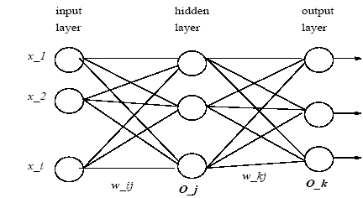
Multilayer Feed-forward Neural Network
A training sample, X = (x1; x2; …; xi), is fed to the input layer.
The weighted outputs of these units are, in turn, fed simultaneously to a second layer, known as a hidden layer.
The hidden layer's weighted outputs can be input to another hidden layer, and so on. The number of hidden layers is arbitrary, although in practice, usually only one is used.
The weighted outputs of the last hidden layer are input to units making up the output layer, which emits the network's prediction for given samples.
Weighted connections exist between each layer, where wij denotes the weight from a unit j in one layer to a unit i in the previous layer.

Slide 61
Benefits and drawbacks of Neural Networks
The network is feed-forward in that none of the weights cycle back to an input unit or to an output unit of a previous layer.
Benefits:
include their high tolerance to noisy data
able to classify patterns on which they have not been trained.
Disadvantages:
involve long training times, so more suitable for applications where this is feasible.
Need to know network topology or “structure".
poor interpretability, as its difficult for humans to interpret the symbolic meaning behind the learned weights.

Slide 62
Defining a network topology
Before training can begin, the user must decide on the network topology by specifying
the number of units in the input layer,
the number of hidden layers (if more than one),
the number of units in each hidden layer, and
the number of units in the output layer.
Normalizing the input values for each attribute in the training samples to fall between 0 and 1.0.

Slide 63
Boolean function OR – Linearly separable

Slide 64
Boolean function AND – Linearly separable

Slide 66
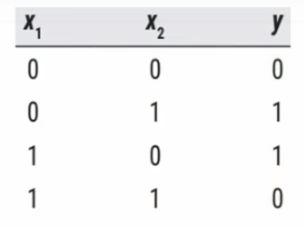
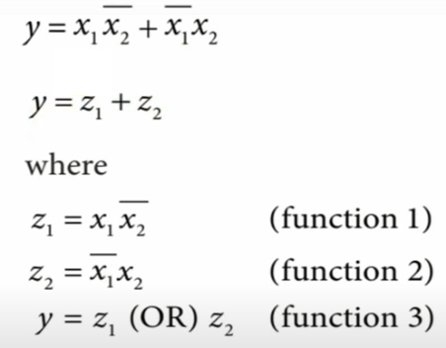
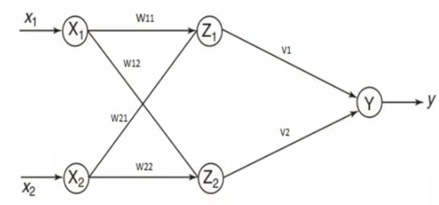
Perceptron for XOR

Slide 67
Backpropagation
“What is backpropagation?"
Its a neural network learning algorithm.
How does it work?
Backpropagation learns by iteratively processing a set of training samples, comparing the network's prediction for each sample with the actual known class label.
For each training sample, the weights are modified so as to minimize the error between the network's prediction and the actual class.
These modifications are made in the “backwards" direction, i.e., from the output layer, through each hidden layer down to the first hidden layer (hence the name backpropagation).

Slide 68
Multi-Layer Perceptron
Output vector
Output nodes
Hidden nodes
w_{ij}
Input nodes
Input vector: x_{i}

Slide 69
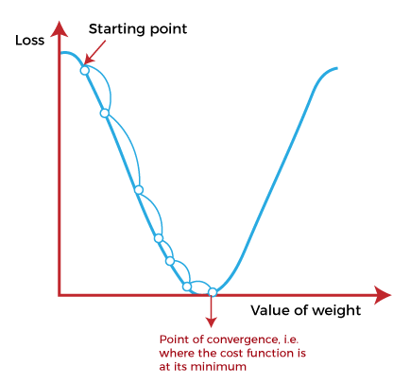
Gradient Descent learning
The starting point is random point
At starting point, derive the first derivative or slope and then use a tangent line to calculate the steepness of this slope. Further, this slope will inform the updates to the parameters (weights and bias).
The slope becomes steeper at the starting point but whenever new parameters are generated, then steepness gradually reduces, and at the lowest point, it approaches the lowest point, which is called a point of convergence.
The main objective of gradient descent is to minimize the cost function or the error between expected and actual.

Slide 70
Given a unit j in a hidden or output layer, the net input,
Ij, to unit j is:
x1
x2
i
j
k
w_{ij}
.
.
.
=Bias(threshold)
xn
Given the net input Ij to unit j, then Oj, the output of unit j, is computed as:
Backpropagate the error. The error is propagated backwards by updating the weights and biases to reflect the error of the network's prediction. Tj=true o/p

Slide 71
Training Algorithm: Backpropagation
The Backpropagation algorithm learns in the same way as single perceptron.
It searches for weight values that minimize the total error of the network over the set of training examples (training set).
Backpropagation consists of the repeated application of the following two passes:
Forward pass: In this step, the network is activated on one example and the error of (each neuron of) the output layer is computed.
Backward pass: in this step the network error is used for updating the weights. The error is propagated backwards from the output layer through the network layer by layer. This is done by recursively computing the local gradient of each neuron.

Slide 72
Backpropagation
Back-propagation training algorithm
Backpropagation adjusts the weights of the NN in order to minimize the network total mean squared error.
Network activation
Forward Step
Error propagation
Backward Step

Slide 73
Contd..
Consider a network of three layers.
Let us use i to represent nodes in input layer, j to represent nodes in hidden layer and k represent nodes in output layer.
w_{ij} refers to weight of connection between a node in input layer and node in hidden layer.
The following equation is used to derive the output value Yj of node j
where, X_{j} = ∑ x_{i} . w_{ij} - θ_{j} , 1≤ i ≤ n; n is the number of inputs to node j, and θ_{j} is threshold for node j

Slide 75
Weight Update Rule
The Backprop weight update rule is based on the gradient descent method:
It takes a step in the direction yielding the maximum decrease of the network error E.
This direction is the opposite of the gradient of E.
Iteration of the Backprop algorithm is usually terminated when the sum of squares of errors of the output values for all training data in an epoch is less than some threshold such as 0.01

Slide 76
Backprop learning algorithm (incremental-mode)
n=1;
initialize weights randomly;
while (stopping criterion not satisfied or n <max_iterations)
for each example (x,d)
- run the network with input x and compute the output y
- update the weights in backward order starting from those of the output layer:
with computed using the (generalized) Delta rule
end-for
n = n+1;
end-while;

Slide 77
Stopping criterions
Total mean squared error change:
Back-prop is considered to have converged when the absolute rate of change in the average squared error per epoch is sufficiently small (in the range [0.1, 0.01]).
Generalization based criterion:
After each epoch, the NN is tested for generalization.
If the generalization performance is adequate then stop.
If this stopping criterion is used then the part of the training set used for testing the network generalization will not used for updating the weights.

Slide 78
Processing at node
Input layer(input Node)
Neurons take in information and send it to the network's other levels. The number of neurons in the input layer must equal the number of features or attributes in the dataset.
No processing at input node.
Represented with Xi.
Hidden layer(Hidden node)
The number of hidden layers will depend on the type of model. In order to actually transfer the input to the next layer, numerous neurons in hidden layers first modify it.
For the purpose of improving predictability, this network's weights are adjusted continuously.
IH_{j} = ∑ (W_{ij} * X_{j})+b_{j}
OH_{j} = sigmoid(IH_{j})

Slide 79
Output layer(Output Node)
For various issues, a distinct activation function should be used in this layer. We want the result to be either 0 or 1 for a binary classification task.
IY_{j} = ∑ (U_{ij} * OH_{j})+ b_{j}
OY_{j} = sigmoid(IY_{j})

Slide 80
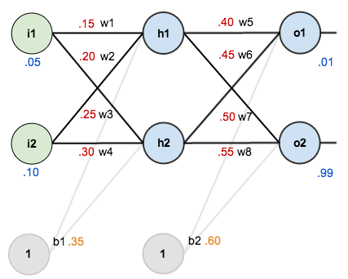

Slide 81
The Forward Pass
Here’s how we calculate the total net input for :
We then squash it using the logistic function to get the output of :
Carrying out the same process for we get:
‘

Slide 82
Repeat this process for the output layer neurons, using the output from the hidden layer neurons as inputs.
Here’s the output for :
And carrying out the same process for we get:

Slide 83
Calculating the Total Error (squared error function)
Repeating this process for (remembering that the target is 0.99) we get:
The total error for the neural network is the sum of these errors:

Slide 84

Backwards Pass
Applying the chain rule

Slide 85
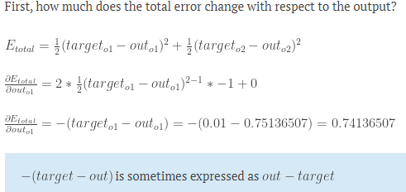

Slide 86
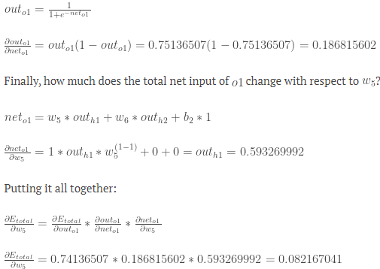

Slide 87
Applying the chain rule

Slide 88
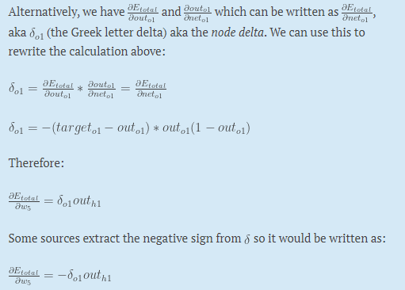

Slide 89
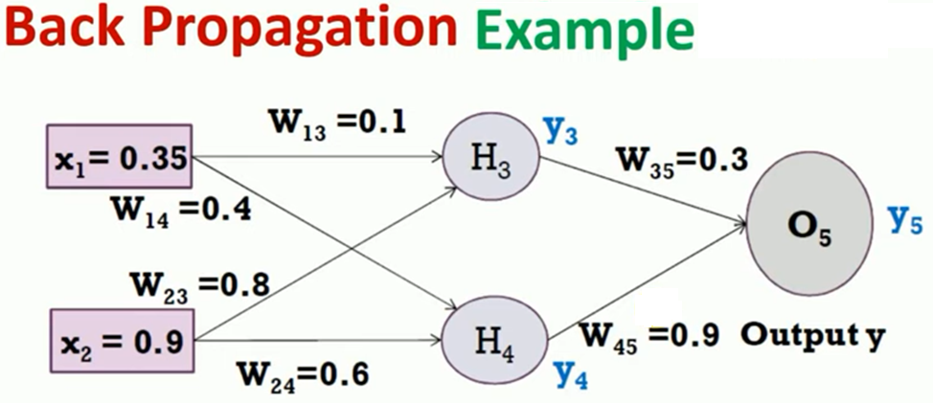

Slide 90
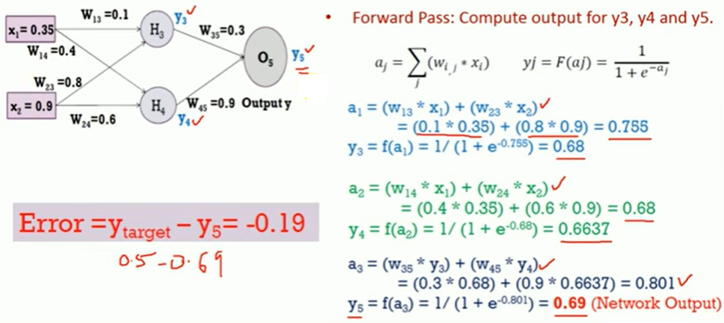
Output y=0.5
Learning rate=1

Slide 92
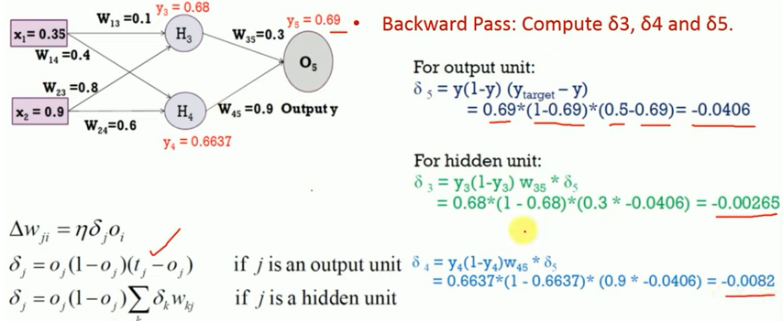

Slide 94
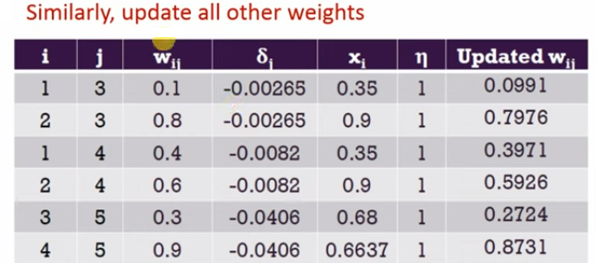

Slide 95
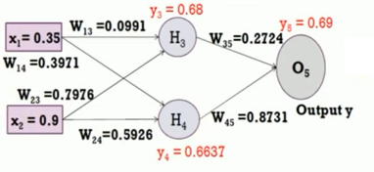
With updated weights

Slide 96
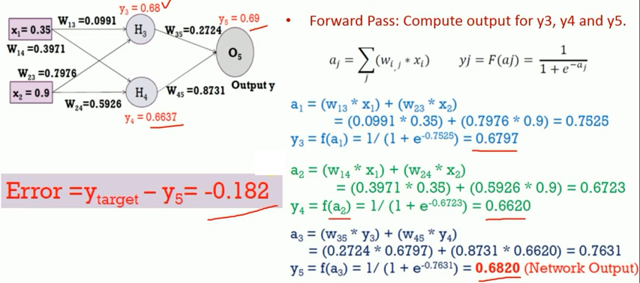

Slide 97
Continue until minimum mean squared error

Slide 98
NN DESIGN ISSUES
Data representation
Network Topology
Network Parameters
Training
Validation

Slide 99
Potential users of ANN
Computer scientists
Statisticians
Engineers
Cognitive scientists
Neuro Psychologists
Physicists
Biologists
Philosophers

Slide 100
Chapter 7. Classification and Prediction
What is classification? What is prediction?
Issues regarding classification and prediction
Classification by decision tree induction
Bayesian Classification
Classification by Neural Networks,Back propagation
Support Vector Machines (SVMs)
k-nearest neighbour classifier
Other Classification Methods
Prediction
Classification accuracy
Summary

Slide 101
Classification: A Mathematical Mapping
Classification: predicts categorical class labels
E.g., Personal homepage classification
x_{i} = (x₁, x₂, x₃, …), y_{i} = +1 or –1
x₁ : # of word “homepage”
x₂ : # of word “welcome”
Mathematically, x ∈ X = ℜ^{n}, y ∈ Y = {+1, –1},
We want to derive a function f: X → Y
Linear Classification
Binary Classification problem
Data above the red line belongs to class ‘x’
Data below red line belongs to class ‘o’
Examples: SVM, Perceptron, Probabilistic Classifiers
x
x
x
x
x
x
x
x
x
o
o
x
o
o
o
o
o
o
o
o
o
o
o
101
Notes:
101

Slide 102
Discriminative Classifiers
Advantages
Prediction accuracy is generally high
As compared to Bayesian methods – in general
Robust, works when training examples contain errors
Fast evaluation of the learned target function
Bayesian networks are normally slow
Criticism
Long training time
Difficult to understand the learned function (weights)
Bayesian networks can be used easily for pattern discovery
Not easy to incorporate domain knowledge
Easy in the form of priors on the data or distributions
102
Notes:
102

Slide 103
SVM—Support Vector Machines
A relatively new classification method for both linear and nonlinear data
It uses a nonlinear mapping to transform the original training data into a higher dimension
With the new dimension, it searches for the linear optimal separating hyperplane (i.e., “decision boundary”)
With an appropriate nonlinear mapping to a sufficiently high dimension, data from two classes can always be separated by a hyperplane
SVM finds this hyperplane using support vectors (“essential” training tuples) and margins (defined by the support vectors)

Slide 104
SVM—History and Applications
Vapnik and colleagues (1992)—groundwork from Vapnik & Chervonenkis’ statistical learning theory in 1960s
Features: training can be slow but accuracy is high owing to their ability to model complex nonlinear decision boundaries (margin maximization)
Used for: classification and numeric prediction
Applications:
handwritten digit recognition, object recognition, speaker identification, benchmarking time-series prediction tests

Slide 105
SVM—General Philosophy
Small Margin
Large Margin
Support Vectors

Slide 106
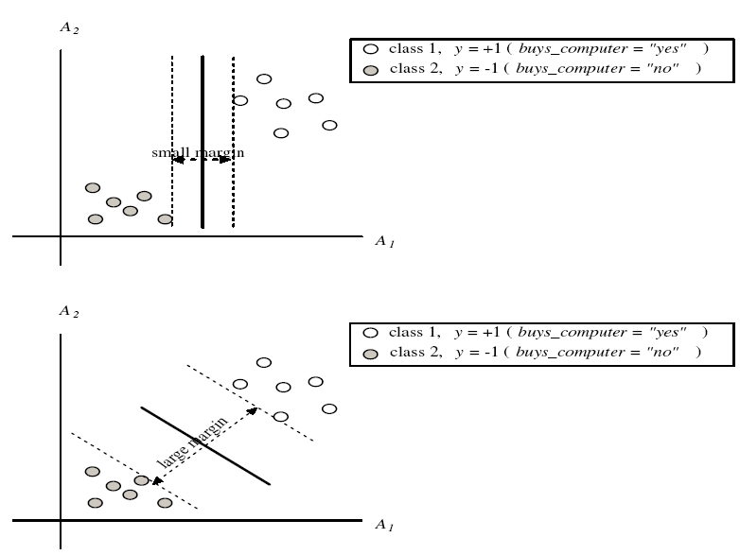
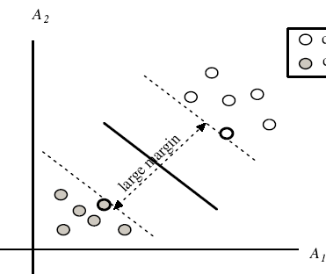
SVM—Margins and Support Vectors

Slide 107
SVM—When Data Is Linearly Separable
m
Let data D be (X₁, y₁), …, (X_{|D|}, y_{|D|}), where X_{i} is the set of training tuples associated with the class labels y_{i}
There are infinite lines (hyperplanes) separating the two classes but we want to find the best one (the one that minimizes classification error on unseen data)
SVM searches for the hyperplane with the largest margin, i.e., maximum marginal hyperplane (MMH)

Slide 108
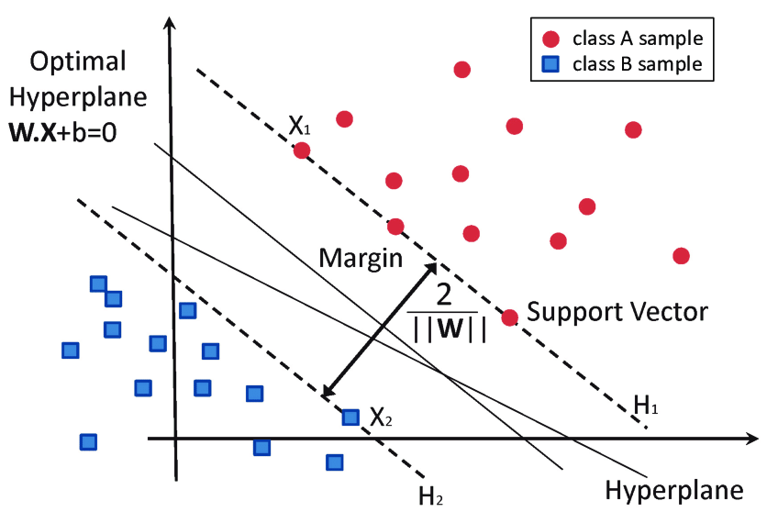
Figure 2.16: Linear support vector machine-SVM

Slide 109
Hyperplane: A decision boundary separating different classes in feature space, represented by the equation wx + b = 0 in linear classification.
Support Vectors: The closest data points to the hyperplane, crucial for determining the hyperplane and margin in SVM.
Margin: The distance between the hyperplane and the support vectors. SVM aims to maximize this margin for better classification performance.
Kernel: A function that maps data to a higher-dimensional space, enabling SVM to handle non-linearly separable data.
Hard Margin: A maximum-margin hyperplane that perfectly separates the data without misclassifications.

Slide 110
Soft Margin: Allows some misclassifications by introducing slack variables, balancing margin maximization and misclassification penalties when data is not perfectly separable.
C: A regularization term balancing margin maximization and misclassification penalties. A higher C value enforces a stricter penalty for misclassifications.
Hinge Loss: A loss function penalizing misclassified points or margin violations, combined with regularization in SVM.
Dual Problem: Involves solving for Lagrange multipliers associated with support vectors, facilitating the kernel trick and efficient computation.

Slide 111
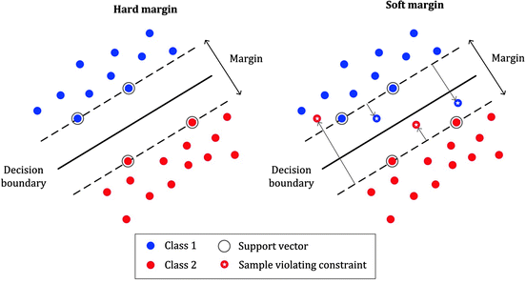
Figure 2.18: Soft Margin

Slide 112
SVM—Linearly Separable
A separating hyperplane can be written as
W ● X + b = 0
where W={w₁, w₂, …, w_{n}} is a weight vector and b a scalar (bias)
For 2-D it can be written as
w₀ + w₁ x₁ + w₂ x₂ = 0
The hyperplane defining the sides of the margin:
H₁: w₀ + w₁ x₁ + w₂ x₂ ≥ 1 for y_{i} = +1, and
H₂: w₀ + w₁ x₁ + w₂ x₂ ≤ – 1 for y_{i} = –1
Any training tuples that fall on hyperplanes H₁ or H₂ (i.e., the sides defining the margin) are support vectors
This becomes a constrained (convex) quadratic optimization problem: Quadratic objective function and linear constraints → Quadratic Programming (QP) → Lagrangian multipliers

Slide 113
Why Is SVM Effective on High Dimensional Data?
The complexity of trained classifier is characterized by the # of support vectors rather than the dimensionality of the data
The support vectors are the essential or critical training examples —they lie closest to the decision boundary (MMH)
If all other training examples are removed and the training is repeated, the same separating hyperplane would be found
The number of support vectors found can be used to compute an (upper) bound on the expected error rate of the SVM classifier, which is independent of the data dimensionality
Thus, an SVM with a small number of support vectors can have good generalization, even when the dimensionality of the data is high

Slide 114
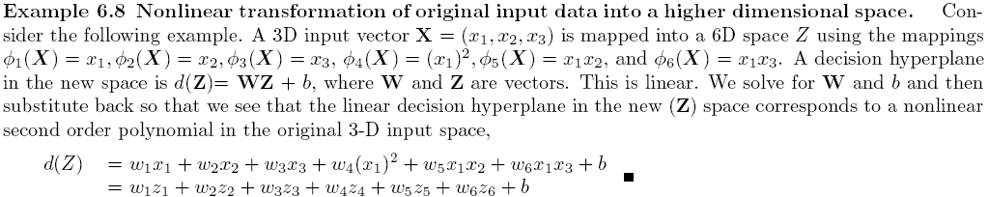
SVM—Linearly Inseparable
Transform the original input data into a higher dimensional space
Search for a linear separating hyperplane in the new space

Slide 115
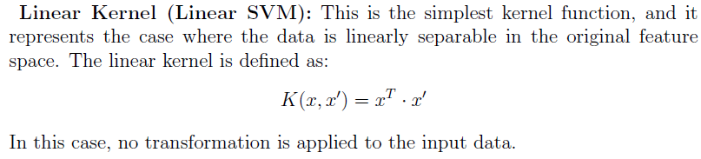
Commonly used kernel functions in SVM
The choice of kernel function has a significant impact on the SVM’s performance. Here are some

Slide 116
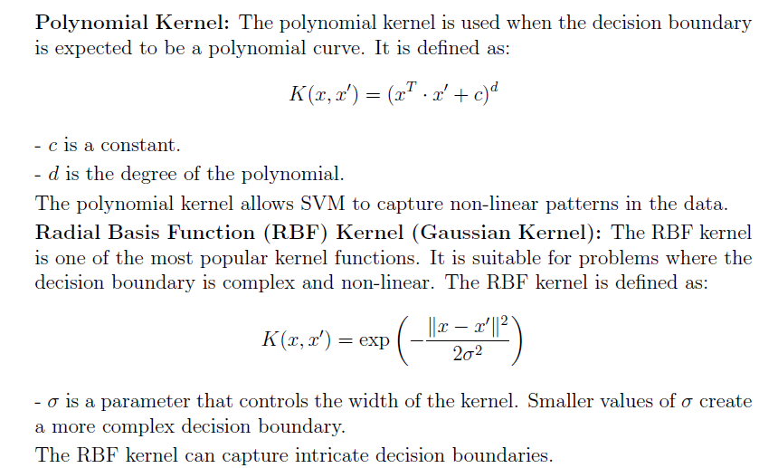

Slide 117
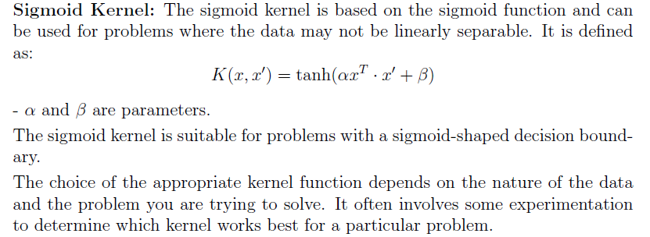

Slide 118
SVM vs. Neural Network
SVM
Deterministic algorithm
Nice generalization properties
Hard to learn – learned in batch mode using quadratic programming techniques
Using kernels can learn very complex functions
Neural Network
Nondeterministic algorithm
Generalizes well but doesn’t have strong mathematical foundation
Can easily be learned in incremental fashion
To learn complex functions—use multilayer perceptron (nontrivial)

Slide 119
Chapter 7. Classification and Prediction
What is classification? What is prediction?
Issues regarding classification and prediction
Classification by decision tree induction
Bayesian Classification
Classification by Neural Networks,Back propagation
Support Vector Machines (SVMs)
k-nearest neighbour classifier
Other Classification Methods
Prediction
Classification accuracy
Summary

Slide 120
Other Classification Methods
k-nearest neighbor classifier
case-based reasoning
Genetic algorithm
Rough set approach
Fuzzy set approaches

Slide 121
Instance-Based (Lazy Learners) Methods
Instance-based learning:
Store training examples and delay the processing (“lazy evaluation”) until a new instance must be classified
Typical approaches
k-nearest neighbor approach
Instances represented as points in a Euclidean space.
Case-based reasoning
Uses symbolic representations and knowledge-based inference
Locally weighted regression
Constructs local approximation

Slide 122
Remarks on Lazy vs. Eager Learning
K Nearest Neighbor & Case based reasoning : lazy evaluation
Decision-tree and Bayesian classification: eager evaluation
Key differences
Lazy Learning | Eager Learning
Store training examples and delay the processing until a new instance must be classified | Constructs generalization model before receiving new samples to classify.
Faster at training | Slower at training
Expensive computational costs when neighbors are more. | Less expensive. Assigns different weights to attributes.
Take more time for predicting Accuracy | Faster at classification as it builds model early.

Slide 123
K Nearest Neighbour
step-by-Step explanation of how KNN works
Step 1: Selecting the optimal value of K
K represents the number of nearest neighbors that needs to be considered while making prediction.
Step 2: Calculating distance
To measure the similarity between target and training data points Euclidean distance is used. Distance is calculated between data points in the dataset and target point.
Step 3: Finding Nearest Neighbors
The k data points with the smallest distances to the target point are nearest neighbors.
Step 4: Voting for Classification or Taking Average for Regression

Slide 124
The k-Nearest Neighbor Algorithm
All instances correspond to points in the n-D space.
The nearest neighbor are defined in terms of Euclidean distance.
The target function could be discrete- or real- valued.
For discrete-valued, the k-NN returns the most common value among the k training examples nearest to X.
Euclidean distance between 2 points: X=(x1,x2,…,xn) Y=(y1,y2,…,yn)

Slide 125
Case-Based Reasoning
Uses: lazy evaluation + analyze similar instances
Instances are not “points in a Euclidean space”
Methodology
Instances represented by rich symbolic descriptions, or as cases.
Earlier similar cases are seen. Multiple retrieved cases may be combined
Tight coupling between case retrieval, knowledge-based reasoning, and problem solving
Research issues
Indexing based on syntactic similarity measure, and when failure, backtracking, and adapting to additional cases

Slide 126
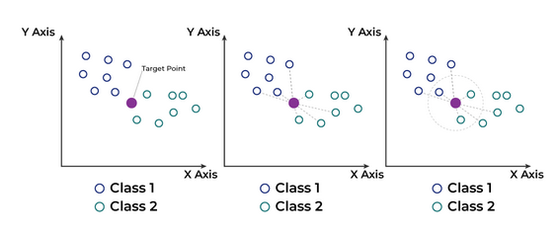

Slide 127
Distance Metrics Used in KNN Algorithm
1. Euclidean Distance
Euclidean distance is defined as the straight-line distance between two points in a plane or space.
distance(x,Xi)=∑j=1d(xj−Xij)2]distance(x,Xi​)=∑j=1d​(xj​−Xij​​)2
2. Manhattan Distance
This is the total distance you would travel if you could only move along horizontal and vertical lines like a grid or city streets.
d(x,y)=∑i=1n∣xi−yi∣d(x,y)=∑i=1n​∣xi​−yi​∣
3. Minkowski Distance
Minkowski distance is like a family of distances, which includes both Euclidean and Manhattan distances as special cases.
d(x,y)=(∑i=1n(xi−yi)p)1pd(x,y)=(∑i=1n​(xi​−yi​)p)p1​

Slide 128
Genetic Algorithms
based on an analogy to biological evolution
Each rule is represented by a string of bits
An initial population is created consisting of randomly generated rules
e.g., IF A₁ and Not A₂ then C₂ can be encoded as 101
Based on the notion of survival of the fittest, a new population is formed to consists of the fittest rules and their offsprings
The fitness of a rule is represented by its classification accuracy on a set of training examples
Offsprings are generated by crossover and mutation

Slide 129
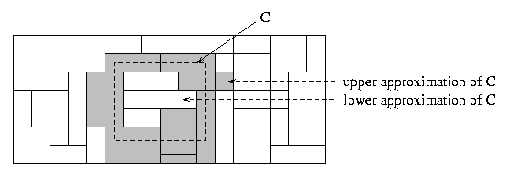
Rough Set Approach
Rough sets are used to approximately or “roughly” define equivalent classes
A rough set for a given class C is approximated by two sets: a lower approximation (certain to be in C) and an upper approximation (cannot be described as not belonging to C)
Finding the minimal subsets (reducts) of attributes (for feature reduction) is NP-hard but a discernibility matrix is used to reduce the computation intensity

Slide 130
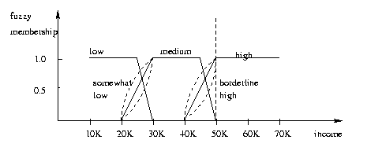
Fuzzy Set Approaches
Fuzzy logic uses truth values between 0.0 and 1.0 to represent the degree of membership (such as using fuzzy membership graph)
Attribute values are converted to fuzzy values
e.g., income is mapped into the discrete categories {low, medium, high} with fuzzy values calculated
For a given new sample, more than one fuzzy value may apply
Each applicable rule contributes a vote for membership in the categories
Typically, the truth values for each predicted category are summed

Slide 131
Chapter 7. Classification and Prediction
What is classification? What is prediction?
Issues regarding classification and prediction
Classification by decision tree induction
Bayesian Classification
Classification by Neural Networks
Classification based on concepts from association rule mining
Other Classification Methods
Prediction
Classification accuracy
Summary

Slide 132
What Is Prediction?
Prediction is similar to classification
First, construct a model
Second, use model to predict unknown value
Major method for prediction is regression
Linear and multiple regression
Non-linear regression
Prediction is different from classification
Classification refers to predict categorical class label
Prediction models continuous-valued functions

Slide 133
Regress Analysis and Log-Linear Models in Prediction
Linear regression: Y = α + β X
Two parameters , α and β specify the line and are to be estimated by using the data at hand.
using the least squares criterion to the known values of Y1, Y2, …, X1, X2, ….
Multiple regression: Y = b0 + b1 X1 + b2 X2.
Many nonlinear functions can be transformed into the above.

Slide 134

Non-linear models:
Polynomial regression can be modeled by adding polynomial terms to the basic linear model.
By applying transformations to the variables, we can convert the nonlinear model into a linear one that can then be solved by the method of least squares.
X1=X, X2=X², X3=X³
The above equation can be converted as

Slide 135
Chapter 7. Classification and Prediction
What is classification? What is prediction?
Issues regarding classification and prediction
Classification by decision tree induction
Bayesian Classification
Classification by Neural Networks
Classification based on concepts from association rule mining
Other Classification Methods
Prediction
Classification accuracy
Summary

Slide 136
Model Evaluation and Selection Classification accuracy
Evaluation metrics: How can we measure accuracy? Other metrics to consider?
Use validation test set of class-labeled tuples instead of training set when assessing accuracy
Methods for estimating a classifier’s accuracy:
Holdout method, random subsampling
Cross-validation
Bootstrap
Comparing classifiers:
Confidence intervals
Cost-benefit analysis and ROC Curves
136

Slide 137
Classifier Evaluation Metrics: Confusion Matrix
Confusion Matrix:
Actual class\Predicted class | C₁ | ¬ C₁
C₁ | True Positives (TP) | False Negatives (FN)
¬ C₁ | False Positives (FP) | True Negatives (TN)
Example of Confusion Matrix:
Actual class\Predicted class | buy_computer = yes | buy_computer = no | Total
buy_computer = yes | 6954 | 46 | 7000
buy_computer = no | 412 | 2588 | 3000
Total | 7366 | 2634 | 10000
Given m classes, an entry, CM_{i,j} in a confusion matrix indicates # of tuples in class i that were labeled by the classifier as class j
May have extra rows/columns to provide totals
137

Slide 138
Classifier Evaluation Metrics: Accuracy, Error Rate, Sensitivity and Specificity
A\P | C | ¬C
C | TP | FN | P
¬C | FP | TN | N
 | P’ | N’ | All
Class Imbalance Problem:
One class may be rare, e.g. fraud, or HIV-positive
Significant majority of the negative class and minority of the positive class
Sensitivity: True Positive recognition rate
Sensitivity = TP/P
Specificity: True Negative recognition rate
Specificity = TN/N
Classifier Accuracy, or recognition rate: percentage of test set tuples that are correctly classified
Accuracy = (TP + TN)/All
Error rate: 1 – accuracy, or
Error rate = (FP + FN)/All
138

Slide 139
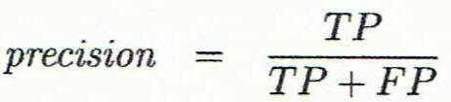
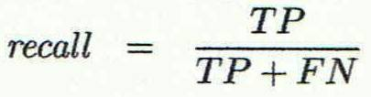
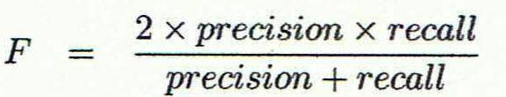
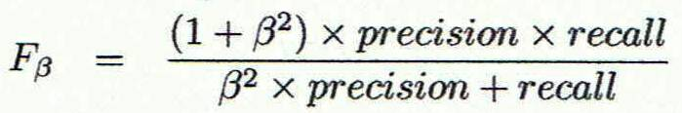
Classifier Evaluation Metrics: Precision and Recall, and F-measures
Precision: exactness – what % of tuples that the classifier labeled as positive are actually positive
Recall: completeness – what % of positive tuples did the classifier label as positive?
Perfect score is 1.0
Inverse relationship between precision & recall
F measure (F₁ or F-score): harmonic mean of precision and recall,
F_{ß}: weighted measure of precision and recall
assigns ß times as much weight to recall as to precision
139

Slide 140
Classifier Evaluation Metrics: Example
Actual Class\Predicted class | cancer = yes | cancer = no | Total | Recognition(%)
cancer = yes | 90 | 210 | 300 | 30.00 (sensitivity
cancer = no | 140 | 9560 | 9700 | 98.56 (specificity)
Total | 230 | 9770 | 10000 | 96.40 (accuracy)
Precision = 90/230 = 39.13% Recall = 90/300 = 30.00%
140

Slide 141
Evaluating Classifier Accuracy: Holdout & Cross-Validation Methods
Holdout method: Given data is randomly partitioned into two independent sets
Training set (e.g., 2/3) for model construction
Test set (e.g., 1/3) for accuracy estimation
Random sampling: a variation of holdout
Repeat holdout k times, accuracy = avg. of the accuracies obtained
Cross-validation (k-fold, where k = 10 is most popular)
Randomly partition the data into k mutually exclusive subsets, each approximately equal size
At i-th iteration, use D_{i} as test set and others as training set
Leave-one-out: k folds where k = # of tuples, for small sized data
*Stratified cross-validation*: folds are stratified so that class dist. in each fold is approx. the same as that in the initial data
141

Slide 142

Evaluating Classifier Accuracy: Bootstrap
Bootstrap
Works well with small data sets
Samples the given training tuples uniformly with replacement
i.e., each time a tuple is selected, it is equally likely to be selected again and re-added to the training set
Several bootstrap methods, and a common one is .632 boostrap
A data set with d tuples is sampled d times, with replacement, resulting in a training set of d samples. The data tuples that did not make it into the training set end up forming the test set. About 63.2% of the original data end up in the bootstrap, and the remaining 36.8% form the test set (since (1 – 1/d)^{d} ≈ e⁻¹ = 0.368)
Repeat the sampling procedure k times, overall accuracy of the model:
142

Slide 143


Estimating Confidence Intervals: Classifier Models M₁ vs. M₂
Suppose we have 2 classifiers, M₁ and M₂, which one is better?
Use 10-fold cross-validation to obtain and
These mean error rates are just estimates of error on the true population of future data cases
What if the difference between the 2 error rates is just attributed to chance?
Use a test of statistical significance
Obtain confidence limits for our error estimates
143

Slide 144
Estimating Confidence Intervals: Null Hypothesis
Perform 10-fold cross-validation
Assume samples follow a t distribution with k–1 degrees of freedom (here, k=10)
Use t-test (or Student’s t-test)
Null Hypothesis: M₁ & M₂ are the same
If we can reject null hypothesis, then
we conclude that the difference between M₁ & M₂ is statistically significant
Chose model with lower error rate
144

Slide 145
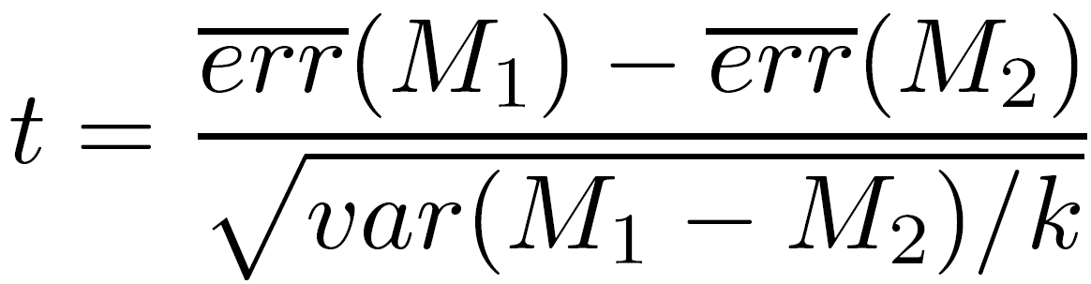

Estimating Confidence Intervals: t-test
If only 1 test set available: pairwise comparison
For i^{th} round of 10-fold cross-validation, the same cross partitioning is used to obtain err(M₁)_{i} and err(M₂)_{i}
Average over 10 rounds to get
t-test computes t-statistic with k-1 degrees of freedom:
If two test sets available: use non-paired t-test
and
where
where
where k₁ & k₂ are # of cross-validation samples used for M₁ & M₂, resp.
145

Slide 146


Estimating Confidence Intervals: Table for t-distribution
Symmetric
Significance level, e.g., sig = 0.05 or 5% means M₁ & M₂ are significantly different for 95% of population
Confidence limit, z = sig/2
146

Slide 147
Estimating Confidence Intervals: Statistical Significance
Are M₁ & M₂ significantly different?
Compute t. Select significance level (e.g. sig = 5%)
Consult table for t-distribution: Find t value corresponding to k-1 degrees of freedom (here, 9)
t-distribution is symmetric: typically upper % points of distribution shown → look up value for confidence limit z=sig/2 (here, 0.025)
If t > z or t < -z, then t value lies in rejection region:
Reject null hypothesis that mean error rates of M₁ & M₂ are same
Conclude: statistically significant difference between M₁ & M₂
Otherwise, conclude that any difference is chance
147

Slide 148
Model Selection: ROC Curves
ROC (Receiver Operating Characteristics) curves: for visual comparison of classification models
Originated from signal detection theory
Shows the trade-off between the true positive rate and the false positive rate
The area under the ROC curve is a measure of the accuracy of the model
Rank the test tuples in decreasing order: the one that is most likely to belong to the positive class appears at the top of the list
The closer to the diagonal line (i.e., the closer the area is to 0.5), the less accurate is the model
Vertical axis represents the true positive rate
Horizontal axis rep. the false positive rate
The plot also shows a diagonal line
A model with perfect accuracy will have an area of 1.0
148

Slide 149
Issues Affecting Model Selection
Accuracy
classifier accuracy: predicting class label
Speed
time to construct the model (training time)
time to use the model (classification/prediction time)
Robustness: handling noise and missing values
Scalability: efficiency in disk-resident databases
Interpretability
understanding and insight provided by the model
Other measures, e.g., goodness of rules, such as decision tree size or compactness of classification rules
149
Notes:
149

Slide 150
Chapter 8. Classification: Basic Concepts
Classification: Basic Concepts
Decision Tree Induction
Bayes Classification Methods
Rule-Based Classification
Model Evaluation and Selection
Techniques to Improve Classification Accuracy: Ensemble Methods
Summary
150
Notes:
150

Slide 151
Increasing Accuracy: Bagging and Boosting
General idea
Training data
Altered Training data
Altered Training data
……..
Aggregation ….
Classification method (CM)
Classifier C
CM
Classifier C1
CM
Classifier C2
Classifier C*

Slide 152
Bagging
Given a set S of s samples
Generate a bootstrap sample T from S. Cases in S may not appear in T or may appear more than once.
Repeat this sampling procedure, getting a sequence of k independent training sets
A corresponding sequence of classifiers C1,C2,…,Ck is constructed for each of these training sets, by using the same classification algorithm
To classify an unknown sample X,let each classifier predict or vote
The Bagged Classifier C* counts the votes and assigns X to the class with the “most” votes

Slide 153
Boosting Technique — Algorithm
Assign every example an equal weight 1/N
For t = 1, 2, …, T Do
Obtain a hypothesis (classifier) h^{(t)} under w^{(t)}
Calculate the error of h(t) and re-weight the examples based on the error . Each classifier is dependent on the previous ones. Samples that are incorrectly predicted are weighted more heavily
Normalize w^{(t+1)} to sum to 1 (weights assigned to different classifiers sum to 1)
Output a weighted sum of all the hypothesis, with each hypothesis weighted according to its accuracy on the training set

Slide 154
Chapter 7. Classification and Prediction
What is classification? What is prediction?
Issues regarding classification and prediction
Classification by decision tree induction
Bayesian Classification
Classification by Neural Networks
Classification based on concepts from association rule mining
Other Classification Methods
Prediction
Classification accuracy
Summary

Slide 155
Summary
Classification is an extensively studied problem (mainly in statistics, machine learning & neural networks)
Classification is probably one of the most widely used data mining techniques with a lot of extensions
Scalability is still an important issue for database applications: thus combining classification with database techniques should be a promising topic
Research directions: classification of non-relational data, e.g., text, spatial, multimedia, etc..

